Slide 1
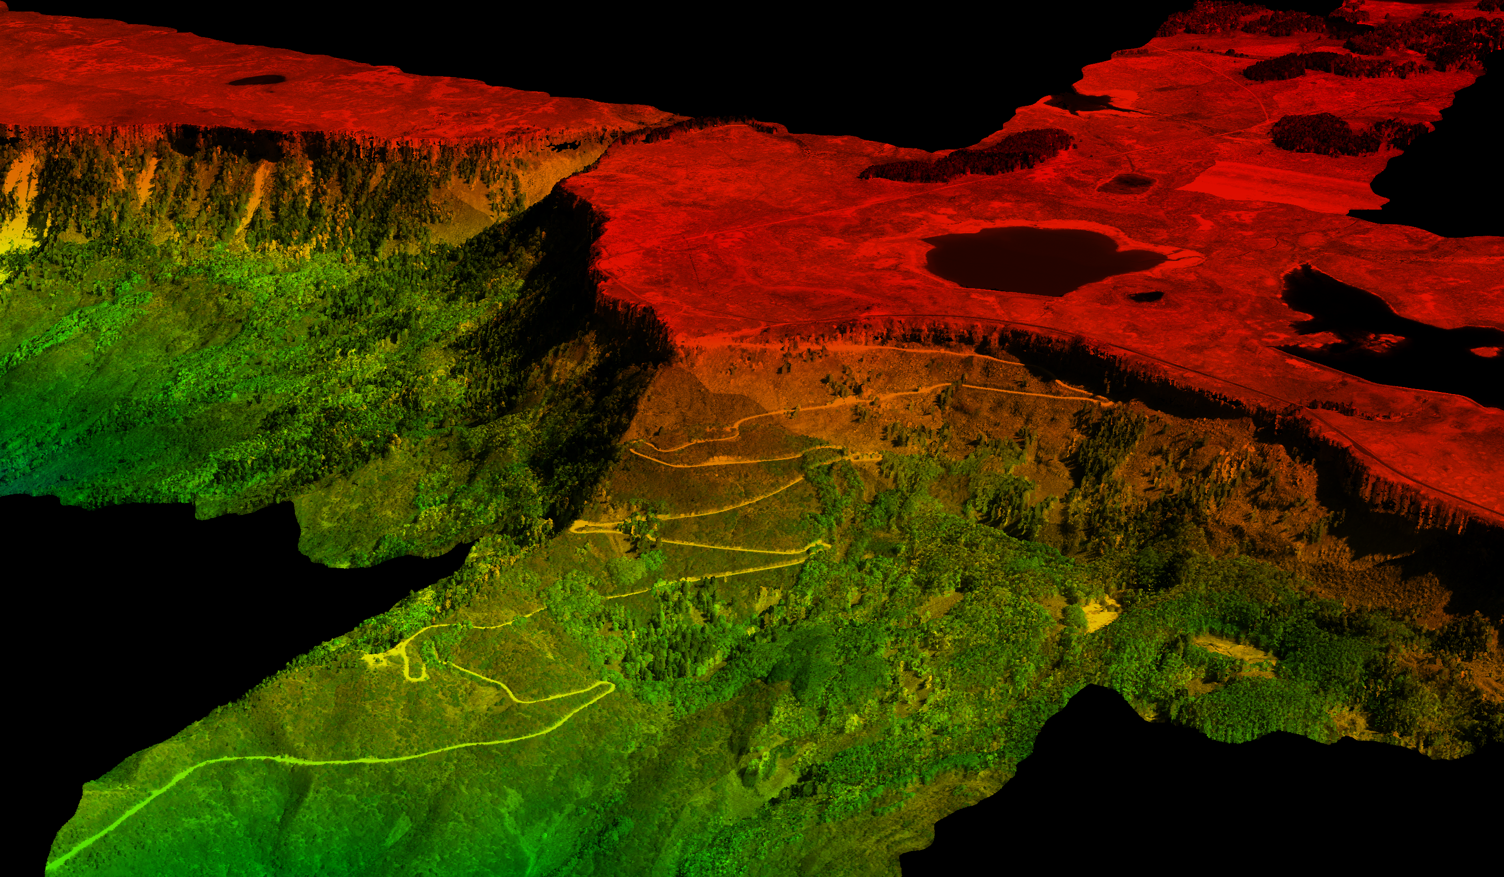

NEON LiDAR Data
LeahAWasser

Slide 2
http://lwasser.github.io/NEON_HigherEd/
For some overview videos about LiDAR data…
Notes:
You take a picture with your iphone of this… what is actually recorded?? Well.. The image is in color. It si called an RGB image because light is recorded in areas of the light spectrum that we can ssee
Red green blue. In the

Slide 3
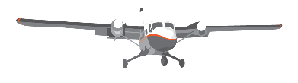
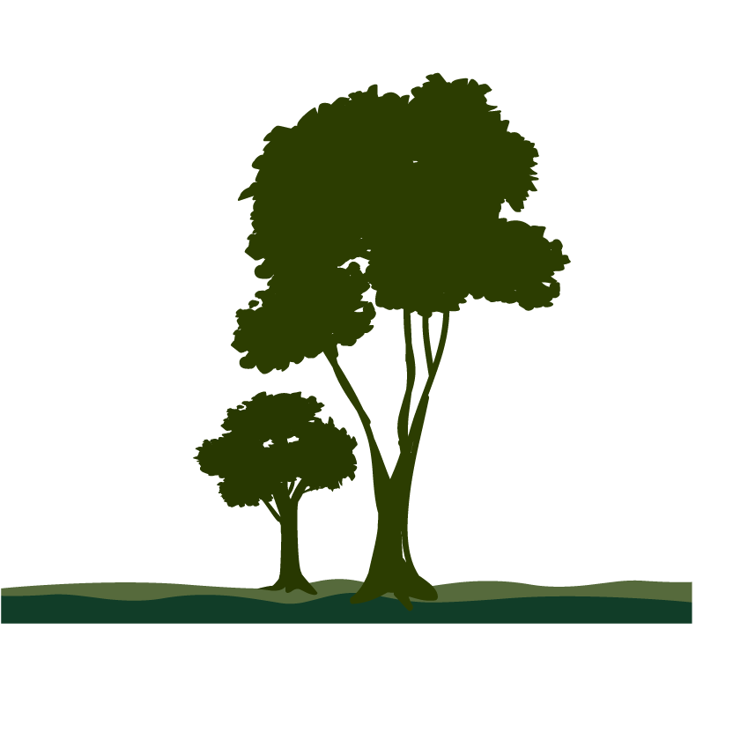
Reflected Light Energy
Time (Elevation)
Returned Energy
Notes:
So, as light travels through a tree and reflects off of branches and leaves, it returns different amounts - or intensities - of light back to the sensor to be recorded. The returned light energy can be thought of as a distribution of more and less returned light energy - like the one you see here on the screen. Notice that time is on the y axis. Remember that a lidar system records the time it takes for the pulse to travel to the ground and back. It then uses that time to calculate distance from the object to the plant. And on the X axis we have the amount of returned energy – which equates to how much light reflects off of an object and returns to the sensor. So, that is how light energy returns to the sensor.

Slide 4
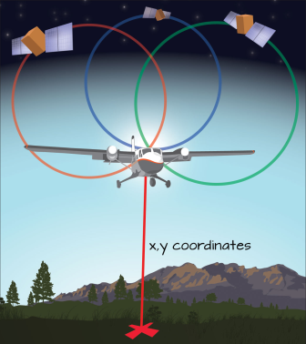
LiDAR Records Geographic Location of Returns
Notes:
Image: Let’s use Colin’s numbers on this slide. We need a creative way to make number “badges” or elements for this and the video.
As light energy returns to the lidar sensor – it records a few important things. First - it records how much light returned to the sensor.

Slide 5
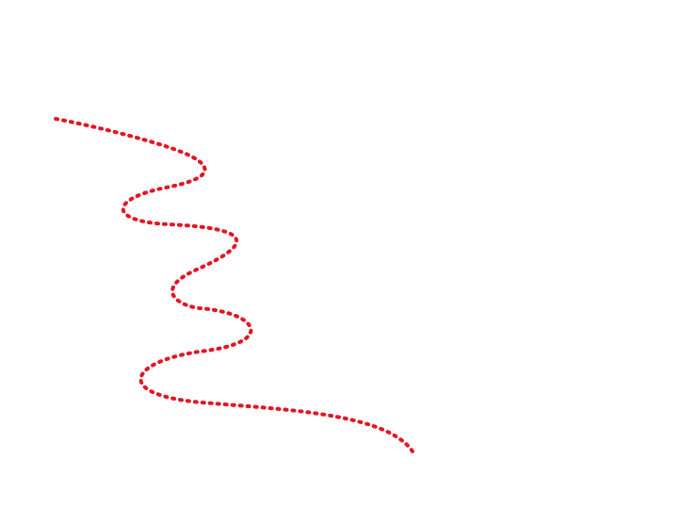
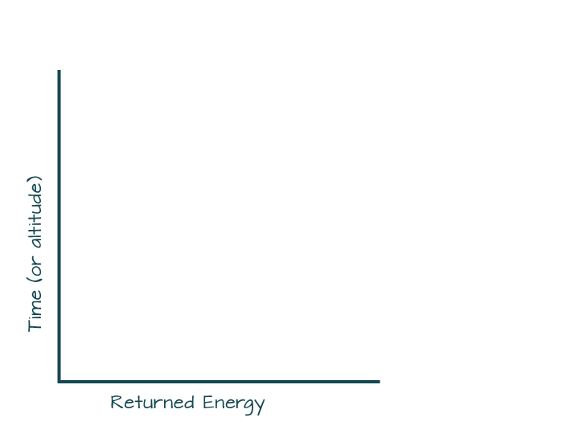
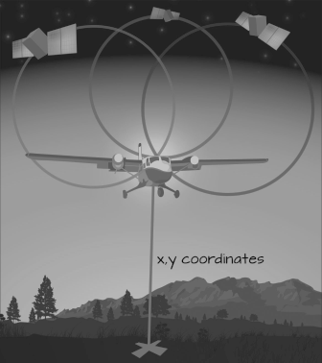

LiDAR Records Travel Time
Travel Time
Geographic Location
Time (Elevation)
Returned Energy
Notes:
Image: Let’s use Colin’s numbers on this slide. We need a creative way to make number “badges” or elements for this and the video.
As light energy returns to the lidar sensor – it records a few important things. First - it records how much light returned to the sensor.

Slide 6
LiDAR Records Amount of Light (Intensity)
Travel Time
Less light energy – lower intensity
Geographic Location
Time (Elevation)
More light Energy – higher intensity
Returned Energy
Notes:
Image: Let’s use Colin’s numbers on this slide. We need a creative way to make number “badges” or elements for this and the video.
As light energy returns to the lidar sensor – it records a few important things. First - it records how much light returned to the sensor.

Slide 7
LiDAR Data Provides X,Y,Z + Intensity
Travel Tie
Geographic Location (x,y)
Travel Time (elevation / z)
Amount of light (intensity)
Geographic Location
Notes:
Image: Let’s use Colin’s numbers on this slide. We need a creative way to make number “badges” or elements for this and the video.
As light energy returns to the lidar sensor – it records a few important things. First - it records how much light returned to the sensor.

Slide 8
Discrete LiDAR - Multiple Returns
First Return: Top of Canopy
Time (Elevation)
Intermediate Returns
Last Return Ground
Returned Energy
Notes:
Image: Adjust the blue squares so they aren’t so ugly ☺ colin used stars… let’s come up with something consistent.
Now, what happens if a pulse of light travels through a tree, with leaves and branches, reflecting light continuously back to the sensor? In this case, the lidar system might record a few returns from the tree and maybe one from the ground. Like this…

Slide 9
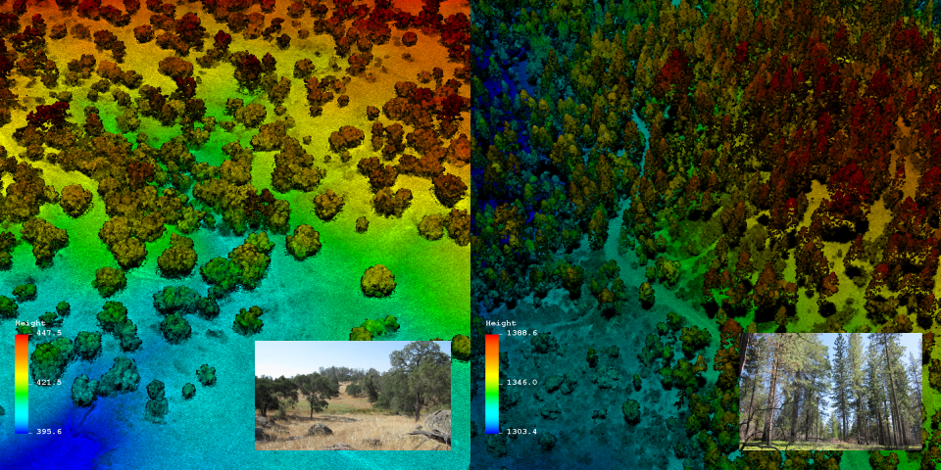
Discrete LiDAR

Slide 10
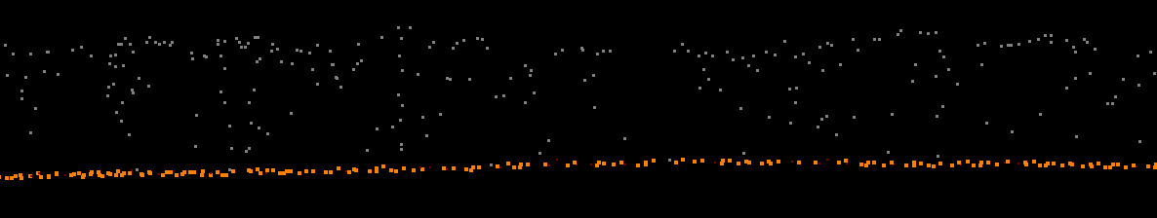
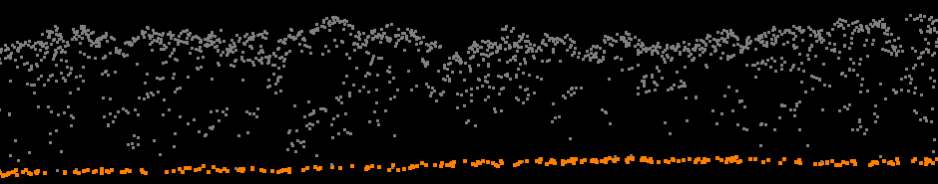
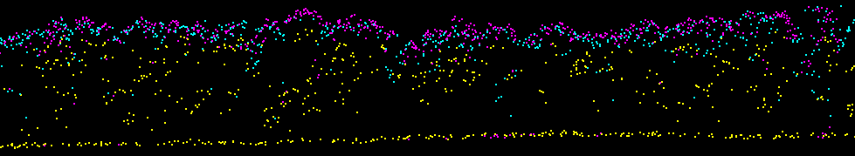
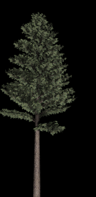
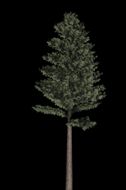
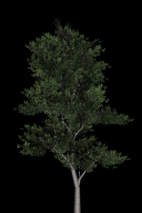
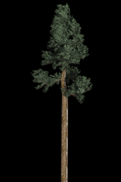
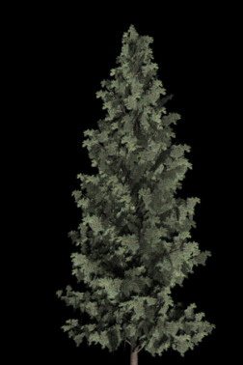
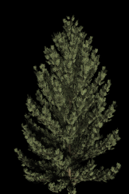
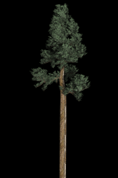
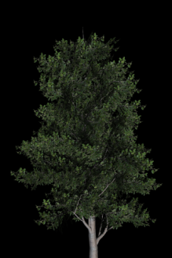
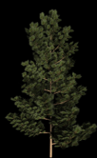

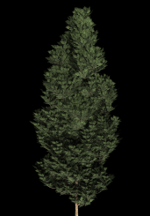
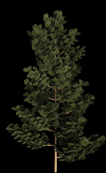
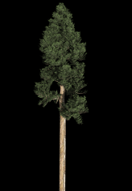
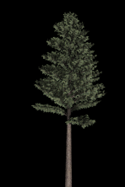
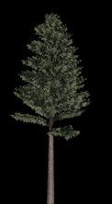
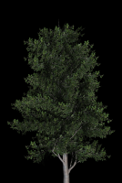
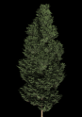
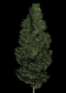
Plas.io
Notes:
Make connection w actual groumd cross sctn

Slide 11
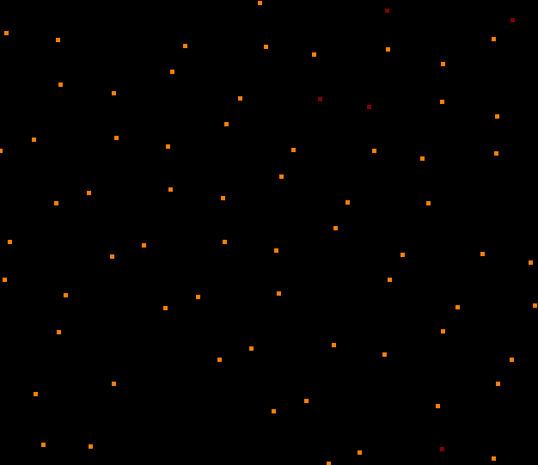

We Derive Rasters From LiDAR Data
Tall Trees
Short Trees

Slide 12
Plas.io
Let’s check out some LiDAR data before going any further.

Slide 13
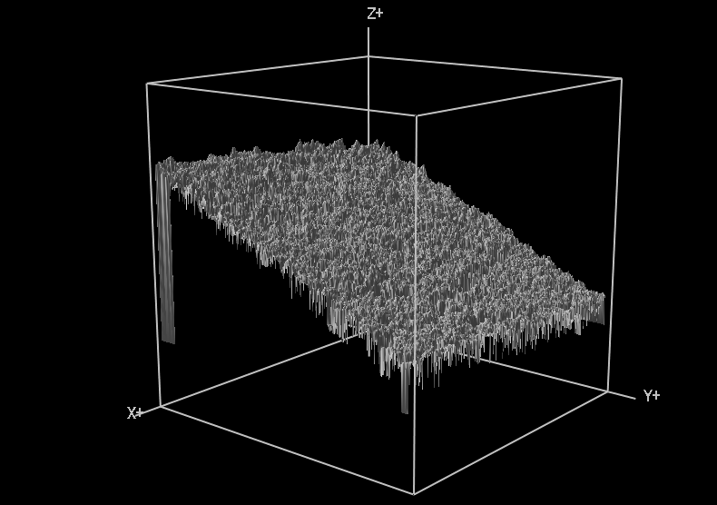
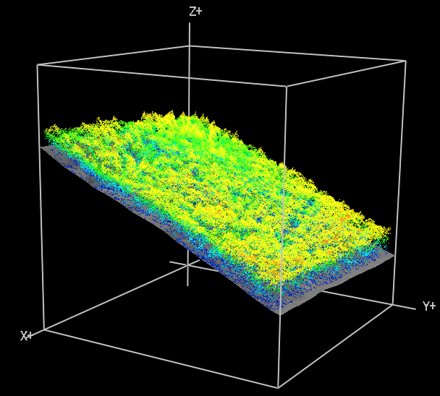
http://neoninc.org/leah_test/ESA2014/DTM.html
Digital Surface Model (DSM)
LiDAR Point Cloud w/DEM surface

Slide 14
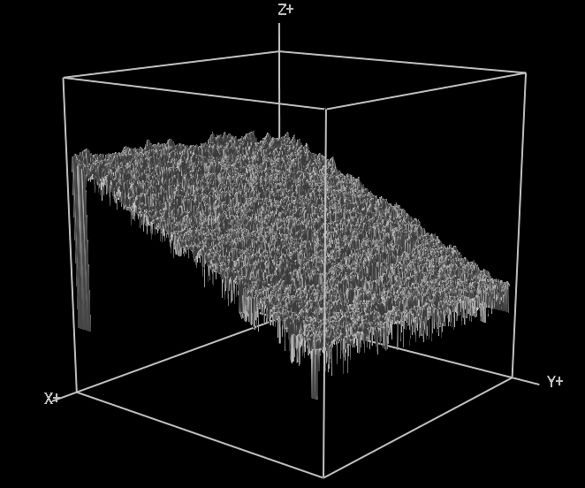
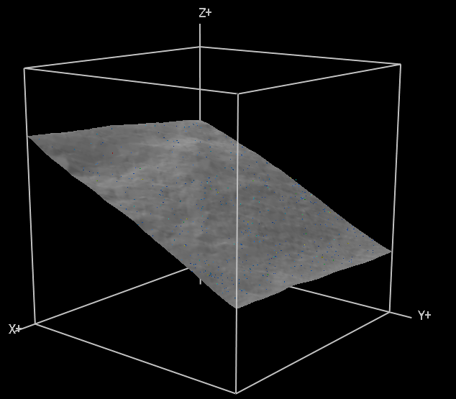
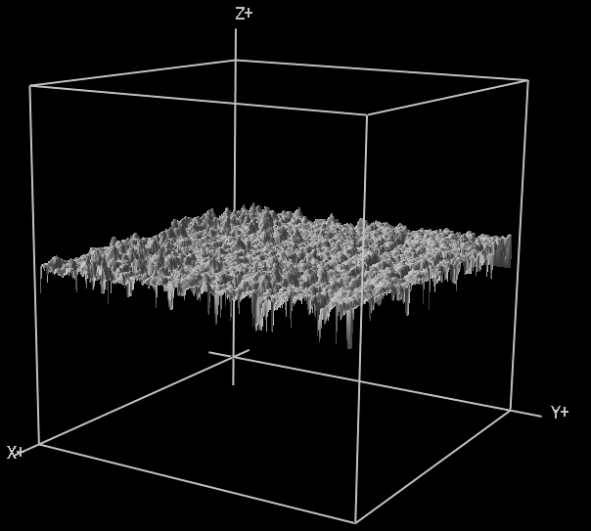
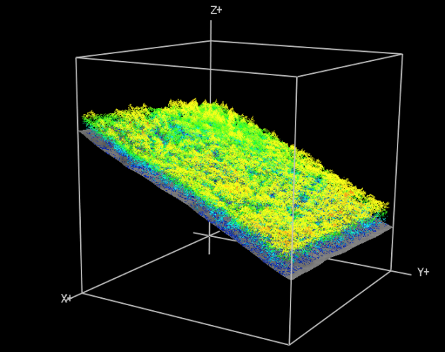
DSM – DEM = Canopy Height Model (CHM)
DSM
DEM
Subtract
Canopy Height Model (CHM)

Slide 15

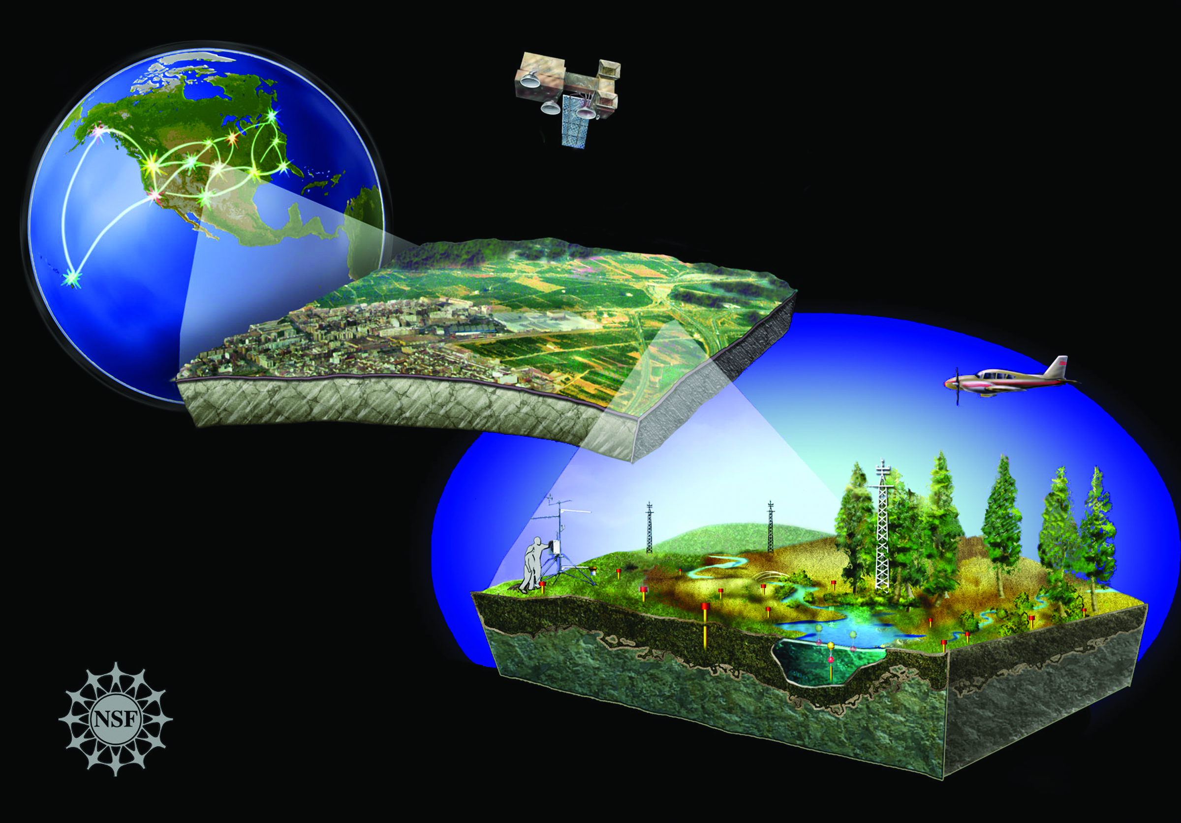

Slide 16

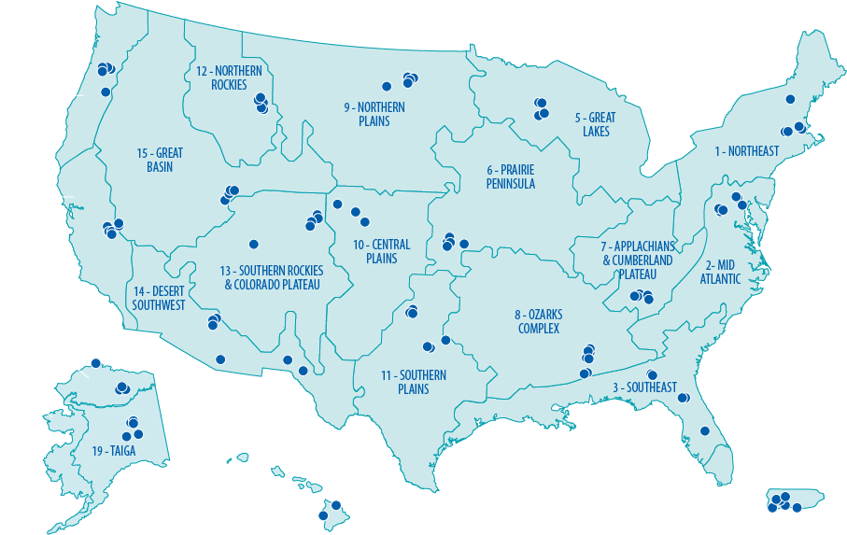
Free ecological data!
www.neoninc.org
Notes:
IMAGE: ADD Free data Stamp that colin made.
Discrete return lidar data will be freely available from the NEON data portal and can also be found on websites like -Open Topography.
Graphics:
Originally placed in E:\UniversityPrograms\GraphicFiles “neonSiteMap.PSD”
Updated Location: E:\UniversityPrograms\Graphics\LIDAR library “NEON_Site_Map.png” (Layered version in zLayered folder)

Slide 17
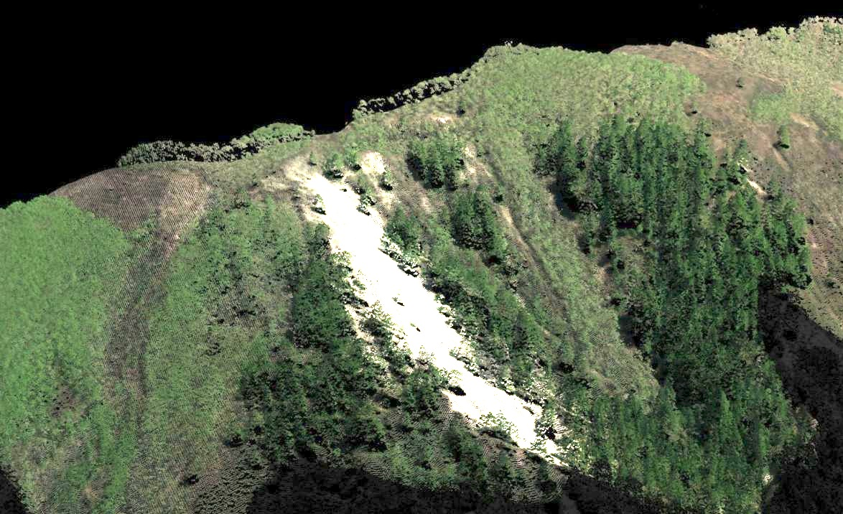
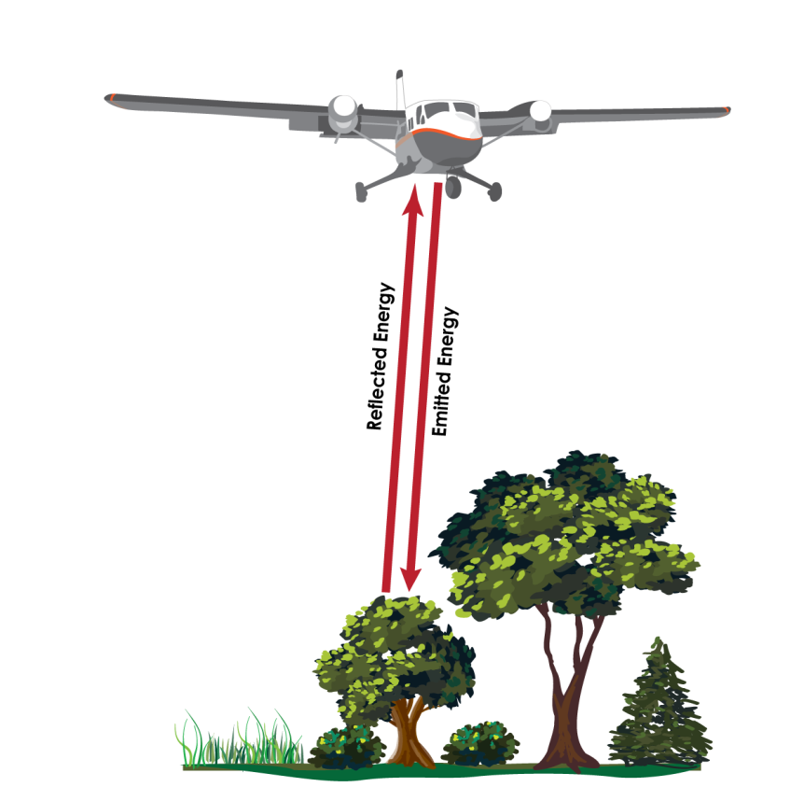
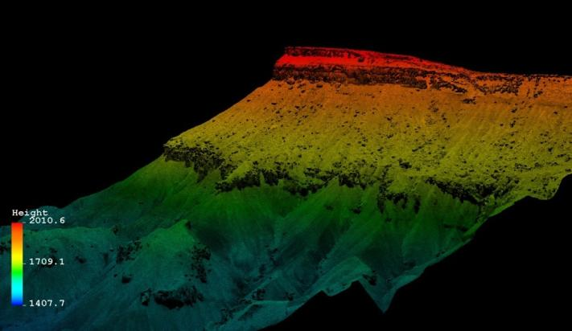
Science and Geolocation with LiDAR

Slide 18
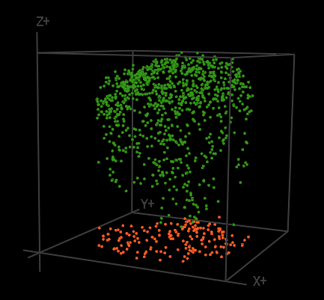
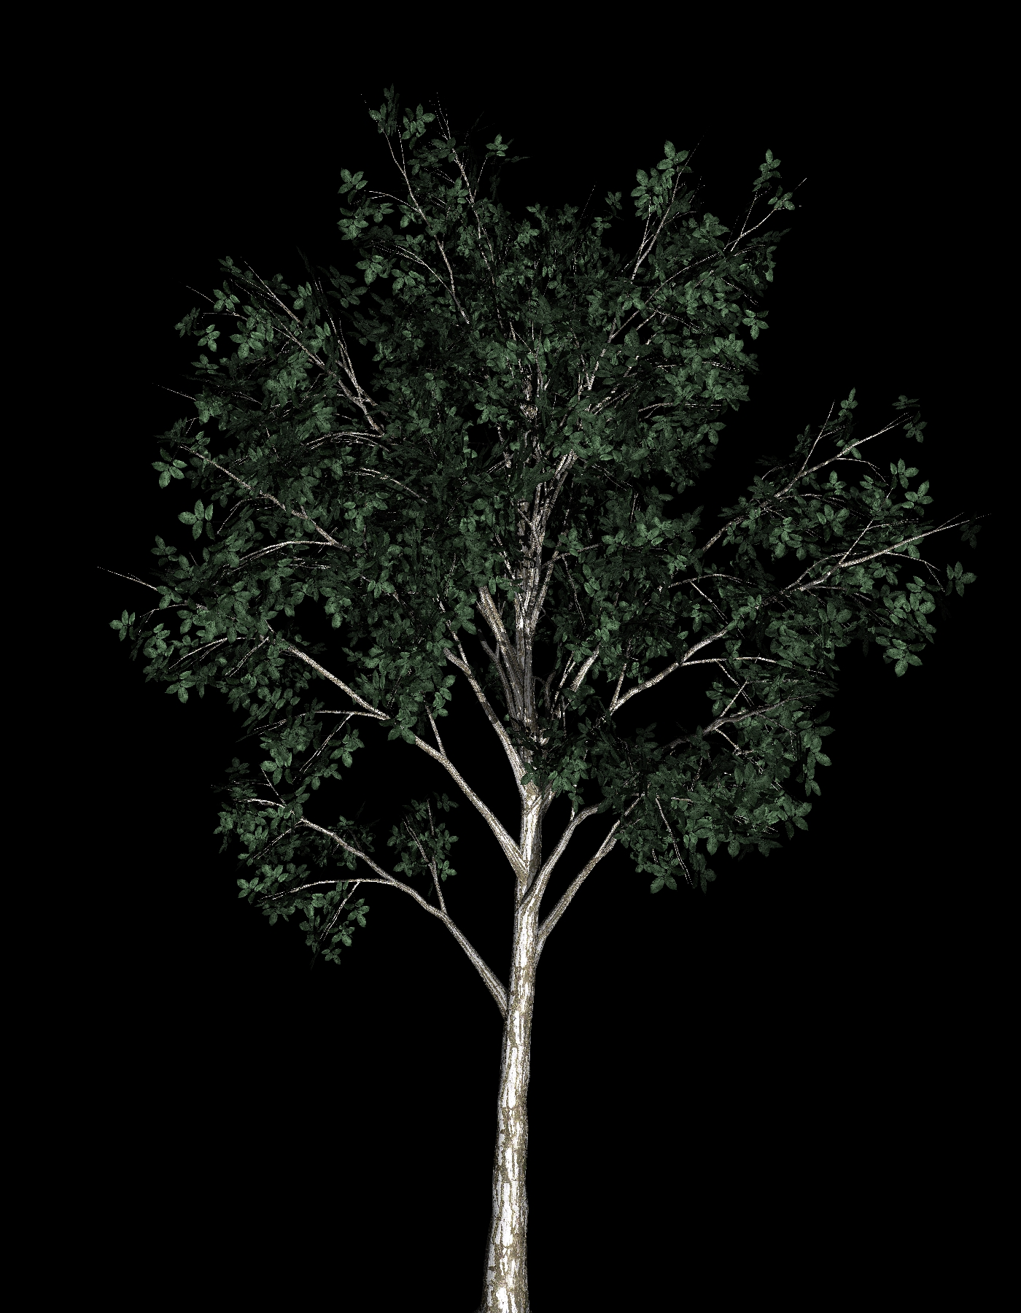
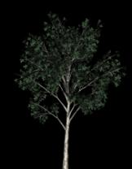
LiDAR Data Products
Vector – Point Clouds
Vegetation Returns
Ground Returns
Raster
Notes:
Sample site selection slide…. Randomly selected
Constraints of sampling (Stratified)
Based upon proximity to stream
Forested
100m
Access – within 1 mile of road, private vs public
Sampling strategy – explain it…
Animate this so the plot map appears first and then the field pictures next…

